Slide 1


Data Structure
Dr Shahjad
Faculty
School of Engineering & Technology
K.R. Mangalam University
Unit 4 : Sorting and Searching
Dr Shahjad

Slide 2

Session Agenda
Session 32 : Introduction to Sorting
Applications of Sorting in Real World
Basic Introduction of Sorting
Bubble Sort
Algorithm and Complexity Analysis of Bubble Sorts
Brainstorming Session
Session 33 :Insertion Sort
Insertion sort
Algorithm and Complexity Analysis of Insertion sort
Example of Insertion Sort
Brainstorming Session

Slide 3

Key Learning Outcomes
Understand the importance of data organization
Analyze data sets to determine the most suitable algorithm
for a given scenario.
Compare and contrast the efficiency and effectiveness of
different searching and sorting algorithms.
Identify opportunities for optimization or improvement in
existing algorithms.

Slide 4
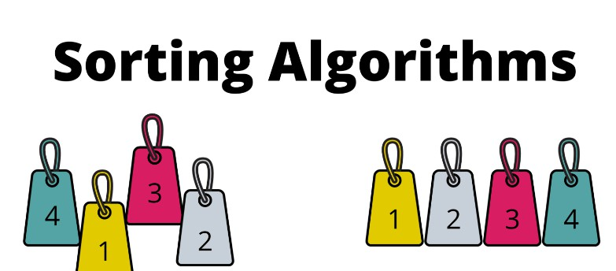
Basic Introduction of Sorting
In data structure, we often need to rearrange elements of our data on basis of increasing/decreasing order to perform our key operation. This process of rearrangement is called Sorting.
Sorting data allows a user to find information faster and easier.

Slide 5

Types of Sorting
The Sorting techniques can be divided into two categories
Comparison based Sorting: determine the order of elements by comparing pairs of elements. The sorting decisions are based solely on these comparisons..
Non Compariosn based Sorting : They do not rely on element comparisons to determine order. Instead, they leverage properties of the input data, often achieving linear or near- linear time complexity under certain conditions.

Slide 6
Applications of Sorting in Computer Science
Database Management: Sorting is crucial for efficient querying
and indexing in databases.
Machine Learning: Sorting is used in preprocessing steps for
feature scaling and normalization.
Parallel Computing: Sorting algorithms are fundamental in
parallel computing for tasks like load balancing and task
scheduling

Slide 7
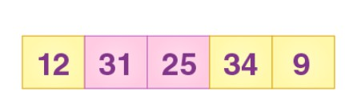
Exercise : Bubble Sort
Sort the following Array using Bubble Sort

Slide 8
Exercise : Bubble Sort
Sort the following Array using Bubble Sort

Slide 9
References
https://www.hackerearth.com/practice/algorithms/sorting/bubble-sort/tutorial/
https://www.freecodecamp.org/news/most-asked-questions-about-bubble-sort/
https://www.scholarhat.com/tutorial/datastructures/bubble-sort-in-data-structures
https://www.scaler.com/topics/data-structures/bubble-sort/
https://visualgo.net/en/sorting
https://www.youtube.com/watch?v=9I2oOAr2okY
Dr. Swati, Ms Suman & Ms Neetu

